Slide 1
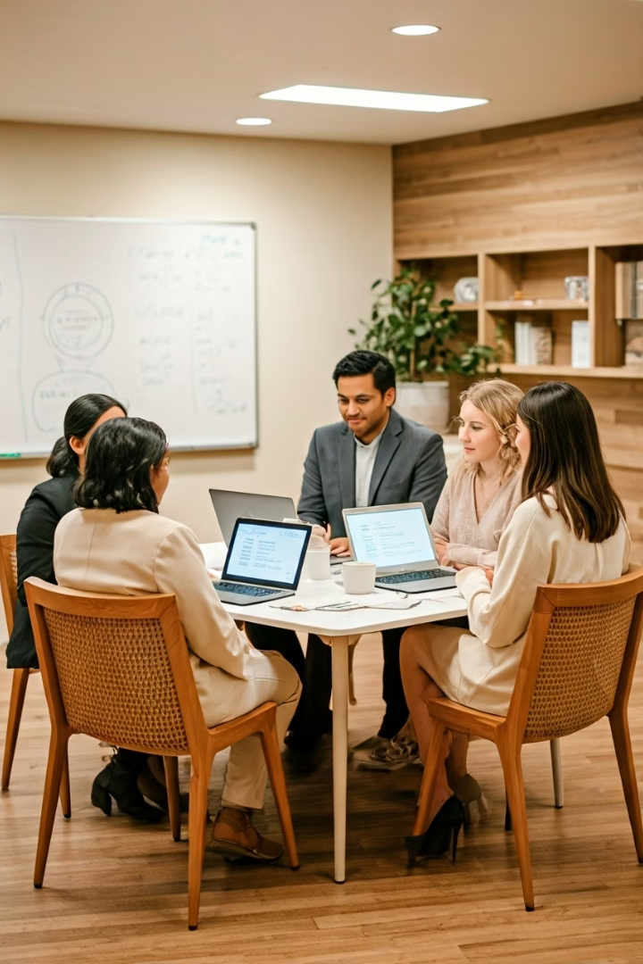
Show-and-Tell Presentation – Subtitle Translator App
Presented by The Sentinels

Slide 2
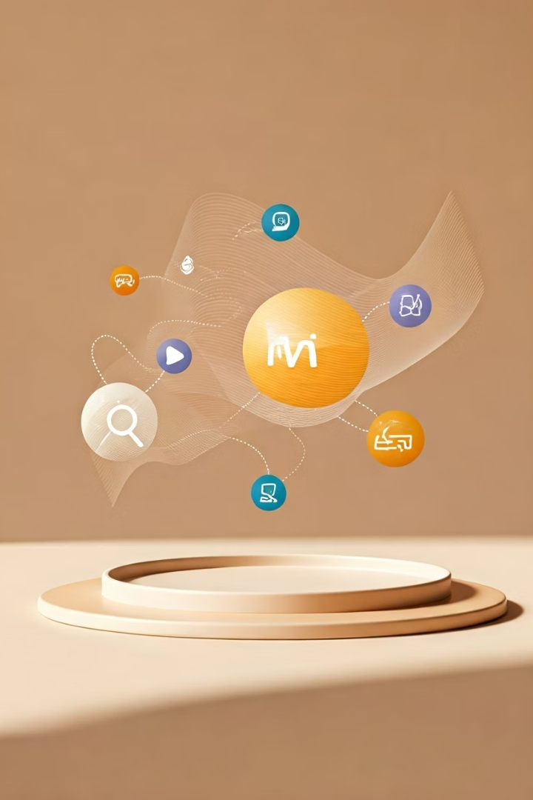




Subtitle Translator App – Project Objectives
Break Language Barriers
Enhance accessibility for multimedia content
Translate Subtitle Files
Supports .srt and .vtt via Azure AI, OpenAI
Real-time Extension
Live translation for YouTube, Netflix
Searchable Library
Store and retrieve translated content

Slide 3
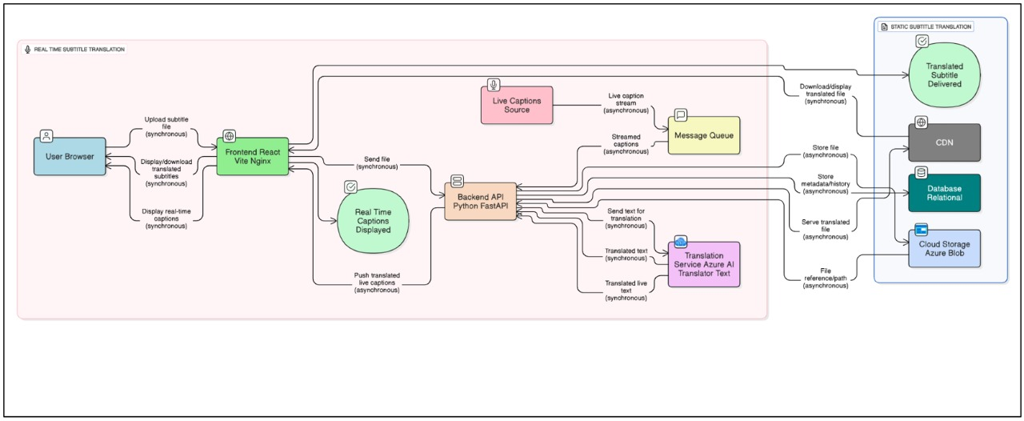
System Architecture Overview

Slide 4
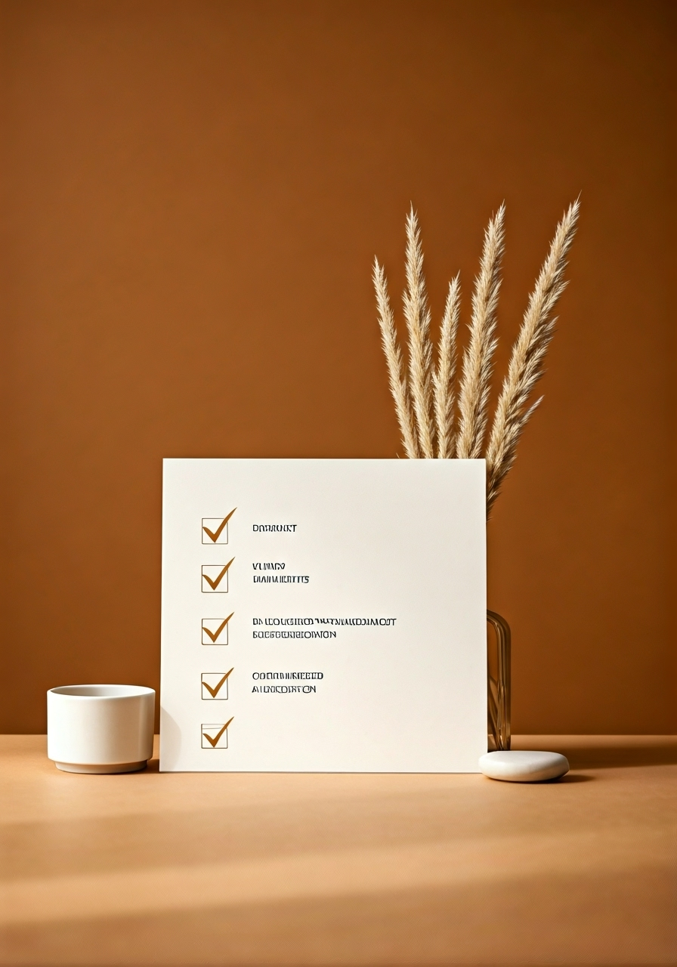
Team Contributions – Sprint 1 (Jun 2 – Jun 8)
Pratham Sharma - UI Enhancements
- Developed static upload UI using React
- Planned UI layout
Rishabh Lingsugur - Planning & Documentation
- Created full project plan document and Show & Tell Presentation - Maintained MoMs in GitHub
Samudra Borkakoti – Backend & AI- Language Detection
- Updated GitHub repo and backend repo structure - Made backend environment and file handling changes
Shivam Sapru - DevOps Support
- Aligned with backend/DevOps planning
Shubham Limkar - DevOps Lead
- Dockerized frontend and backend services - Set up feature branches and deployment base
Yadnesh Sirdeshmukh - API Developer
- Built FastAPI endpoints for subtitle upload
- Worked on download flow and translation logic

Slide 5




Upcoming Sprint Goals
Frontend–Backend Integration
Connect the subtitle upload interface with backend APIs for translation and file handling.
Subtitle Download Flow
Enable users to download translated .srt and .vtt subtitle files.
Language Detection & Translator Improvements
Integrate source language detection and optimize Azure Translator usage.
UI Enhancements
Add hamburger menu, improve layout for responsiveness, and insert placeholder for user profile.
.

Slide 6
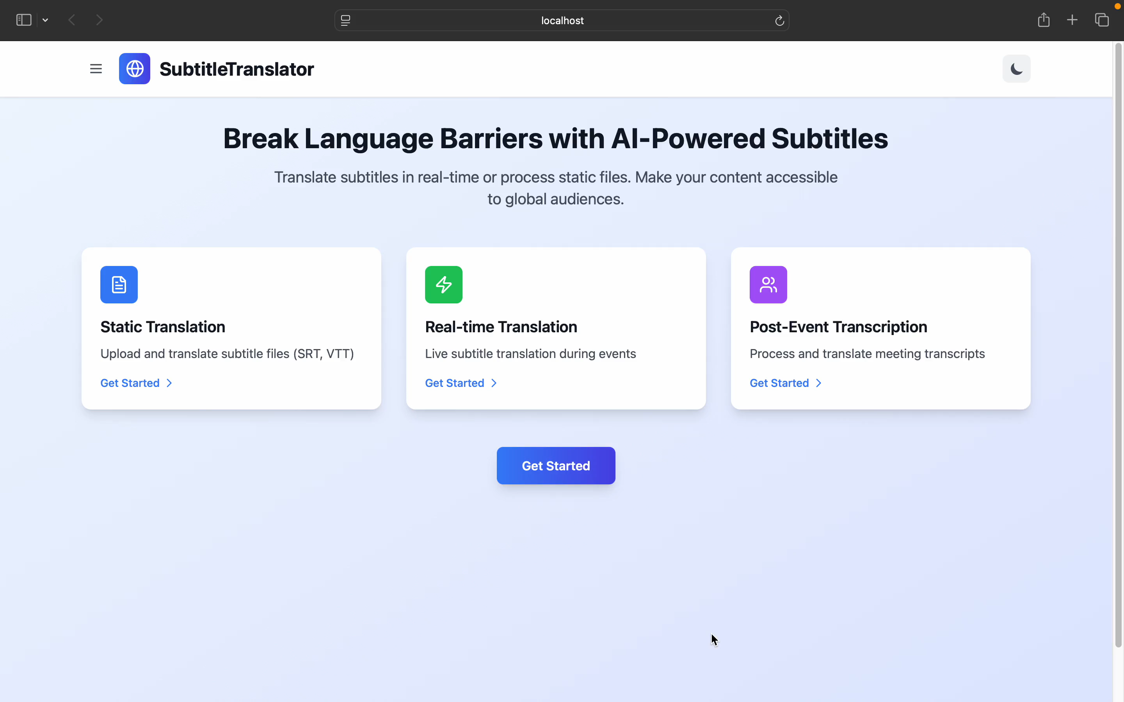
Demo of Current System

Slide 7
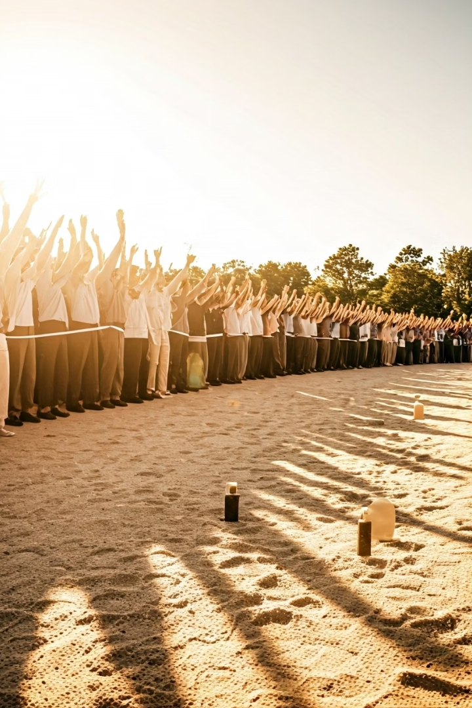




Next Steps & Call to Action
On Track for MVP
Interim Demo Prep
Integration Testing
Meeting all primary goals
June 23rd presentation
Underway and progressing well
Mentor Feedback
Highly valued and welcome
We are on track for our MVP goals and preparing for the Interim Demo on June 23. Integration testing is underway. Feedback from mentors is welcome!

